Slide 1


King Country House Sales Prices and Seattle Venues Exploring
Yun Chen
January 01, 2020

Slide 2
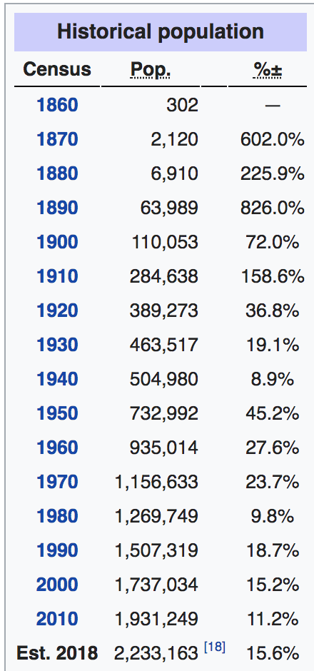
Introduction
The population of King county was about 2,233,163 in the 2018 census estimate. According to Zillow, the median home value in King County is $626,665.
King County home values have declined -2.1% over
the past year and Zillow also predicts
they will rise 1.6% within the next year.

Slide 3
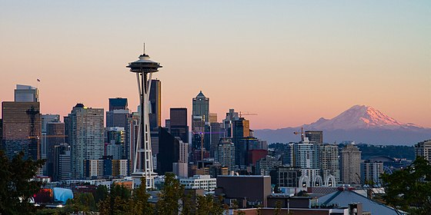

Is it worth moving to Seattle/ King County?
If you just got an offer from top 10 company with a considerable salary, you might start to think about whether if it worth to move to Seattle.
How’s live over there?

Slide 4



Data Source
1. Simplemap – geo info
2. Zillow – king county home sales prices
3. Foursquare API – venues exploring

Slide 5
Data Cleaning
1. Extracting useful columns from the original data frame.
2. Detecting missing data
3. Handling NaN values.

Slide 6
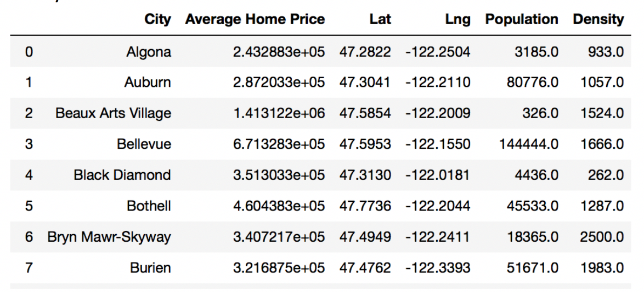
Construct New Data Frame

Slide 7
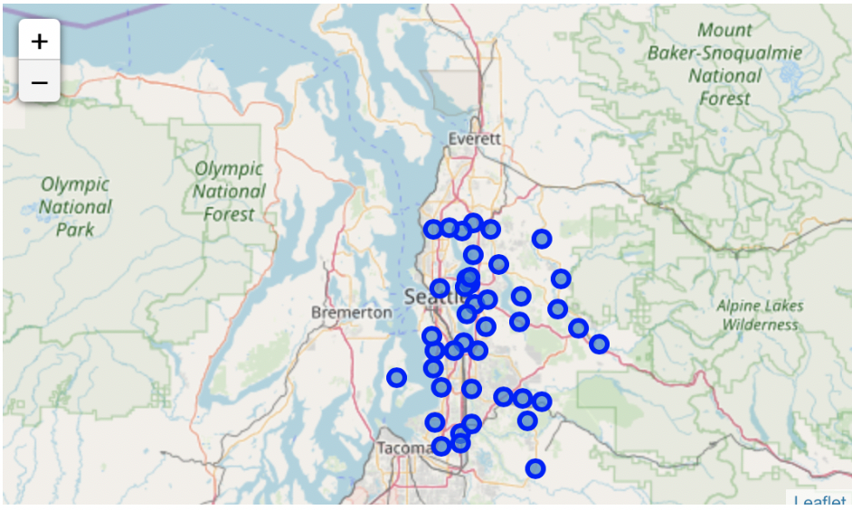
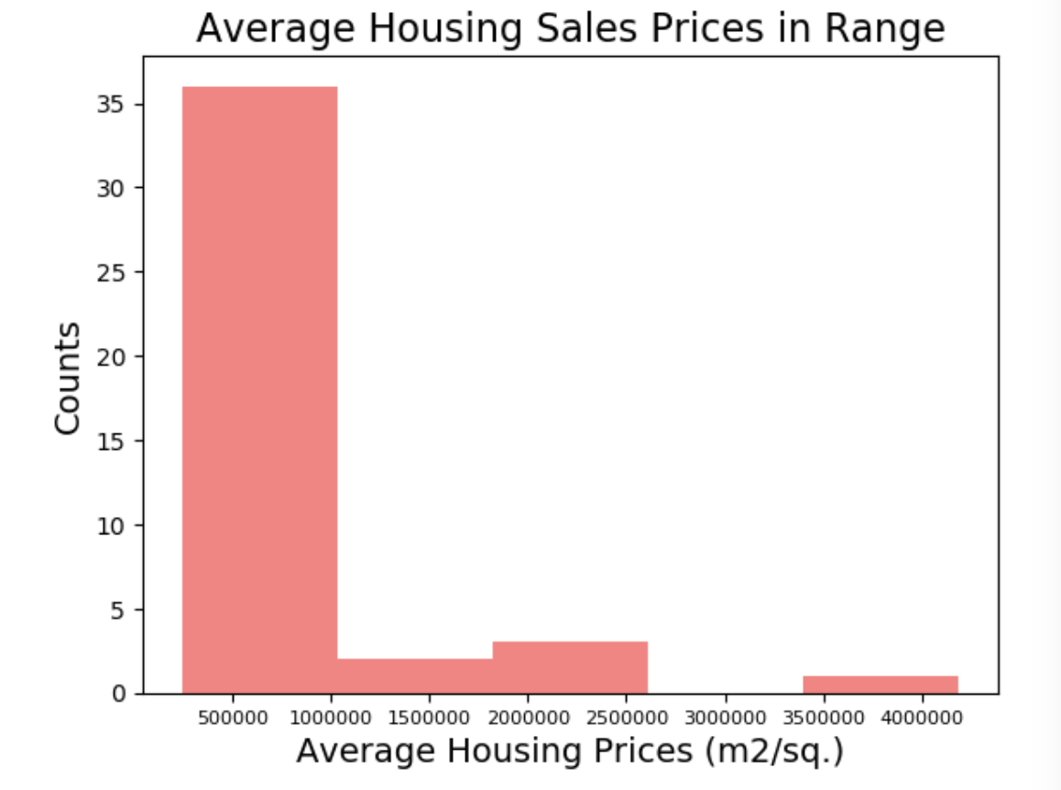
Data Visualization

Slide 8
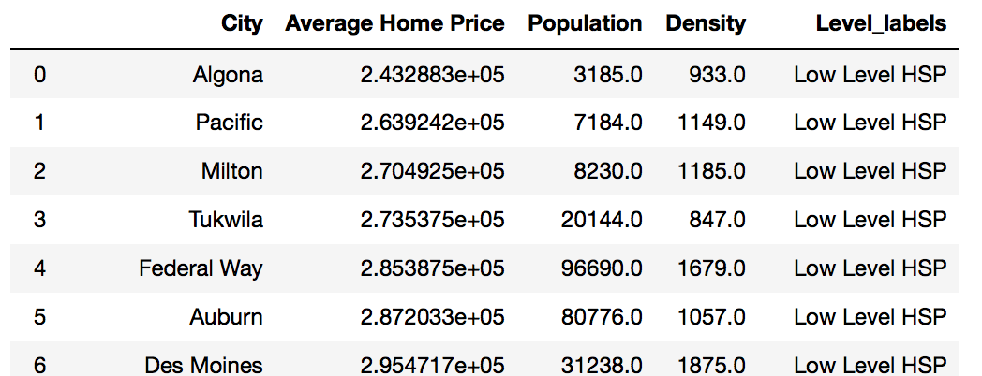
Categorized House Sales Price

Slide 9
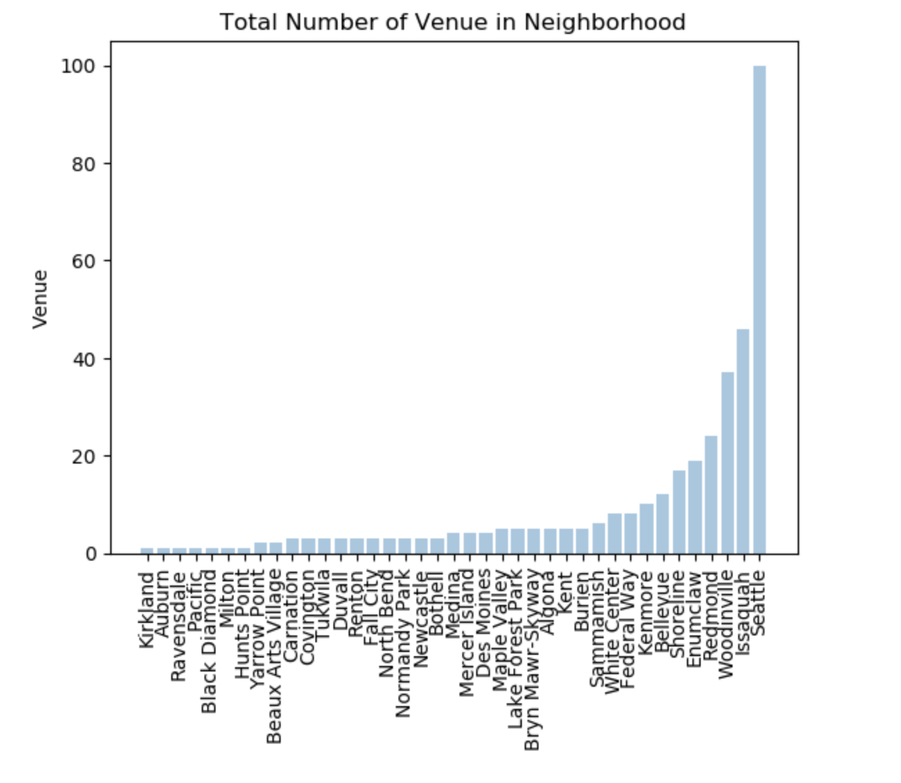
Venues Exploring by FourSquare API

Slide 10
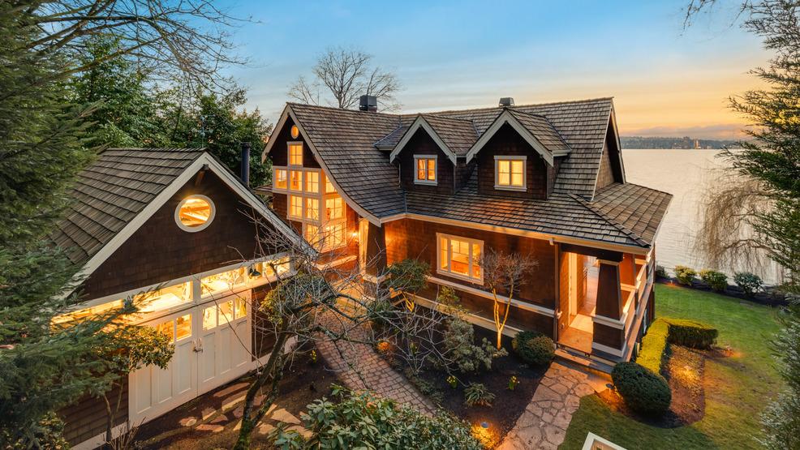
Conclusion
City | House price level
Hunts Points | High level
Medina, Yarrow Point, Clyde Hill | Mid-2 level
Mercer Island, Beaux Arts Village | Mid-1 level
Rest of all | Low level

Slide 11
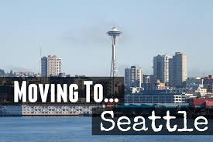
Reference
simplemaps_United Satates Cities Database
King County house sales price by zillow
FourSquare API

